Slide 1
Unpacking the Newest in NuGet
Allie Barry & Jon Douglas

Slide 2
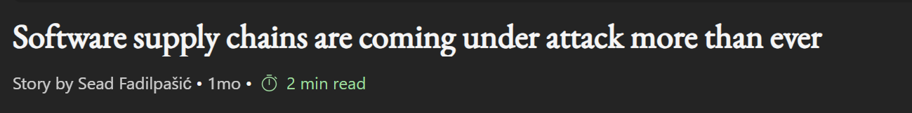
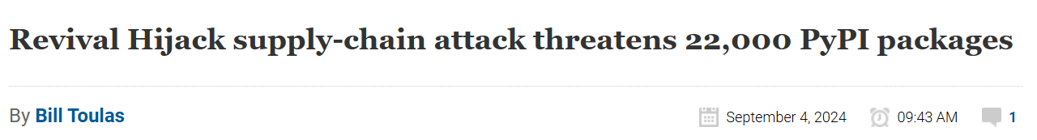
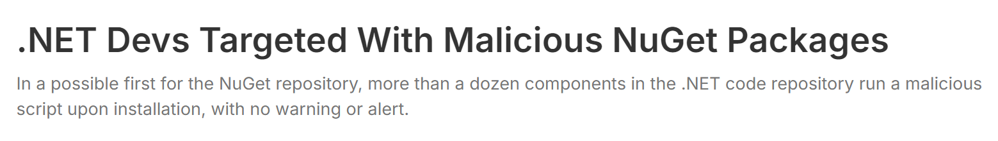
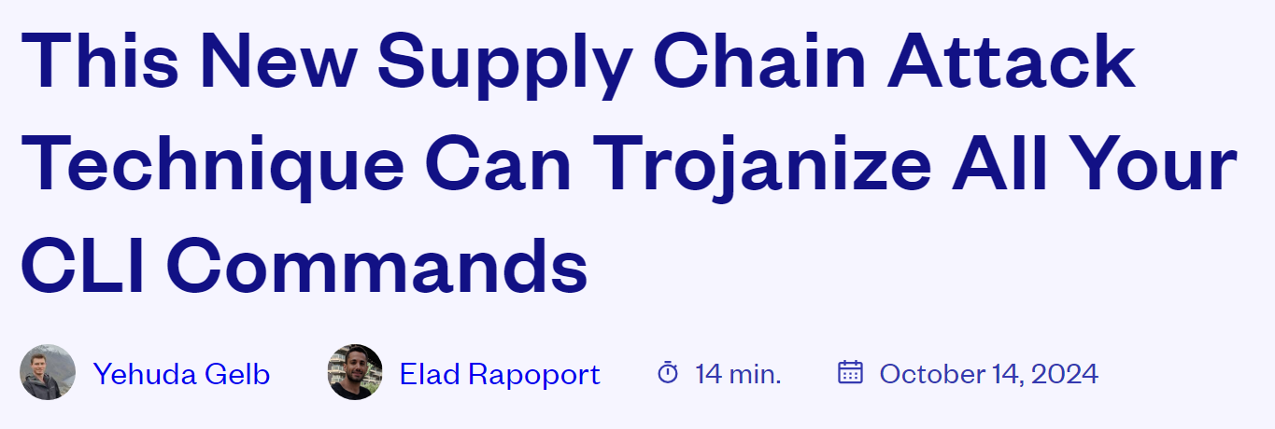
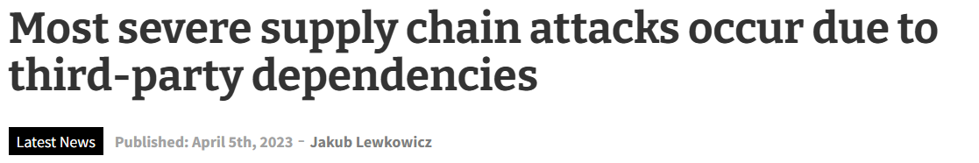
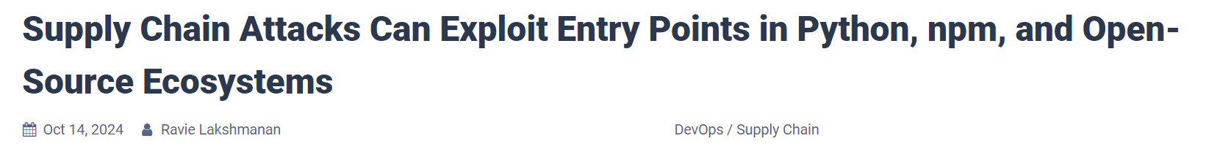
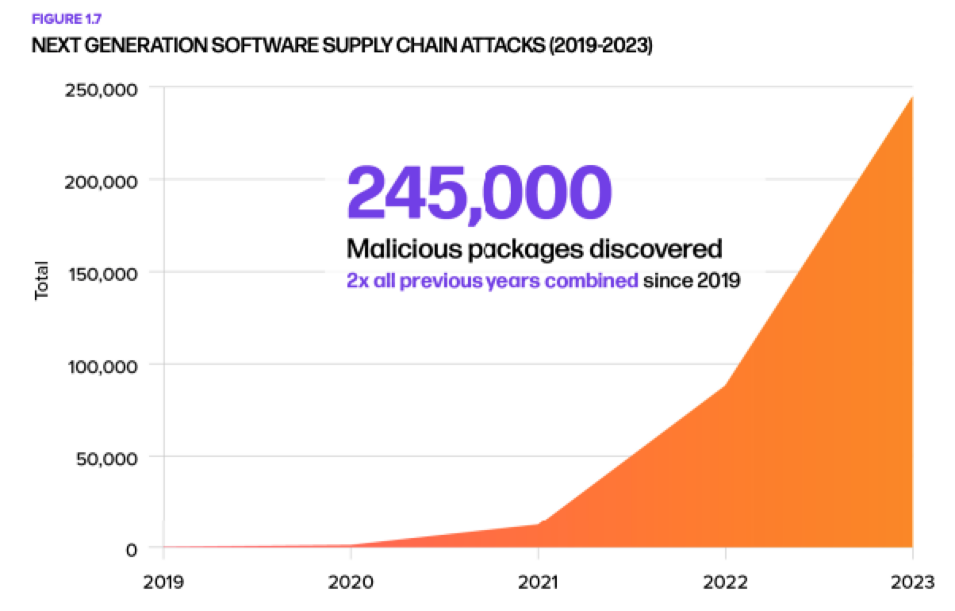
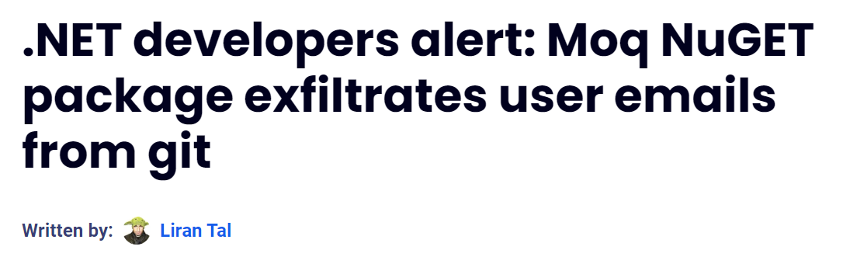
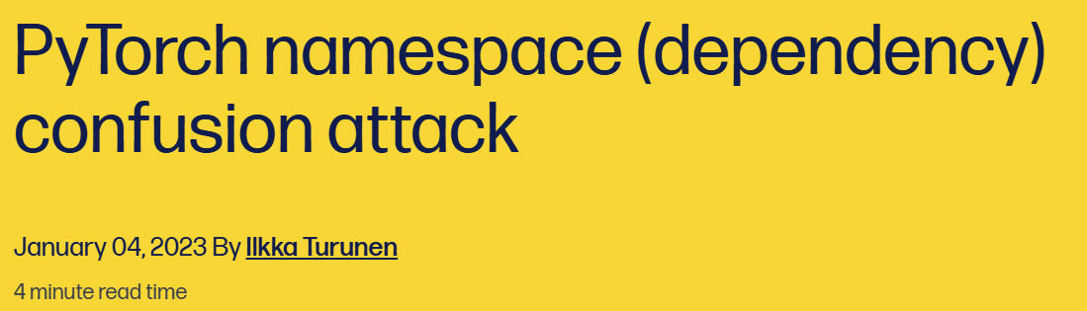
Software supply chain attacks are on the rise

Slide 3
dotnet restore: Audit improvements
So, what is the NuGet team doing about it?
Transitive Dependencies: Awareness tooling
OIDC: Trusted Publishers
SBOM: Inclusion in dotnet SDK
dotnet nuget why: Dependency graph
Partnerships: OpenSSF. GitHub, Deps.dev

Slide 4
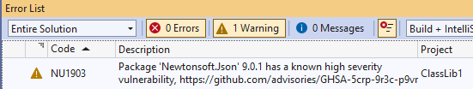
dotnet restore audit improvements
Helping you stay secure by default
The default audit now checks all dependencies, including both direct and indirect ones.
Use NuGetAuditSuppress to ignore certain warnings or advisories.
Set auditSources to use NuGet.org as your trusted source for security advice.
* In .NET 9 and Visual Studio 17.12

Slide 5
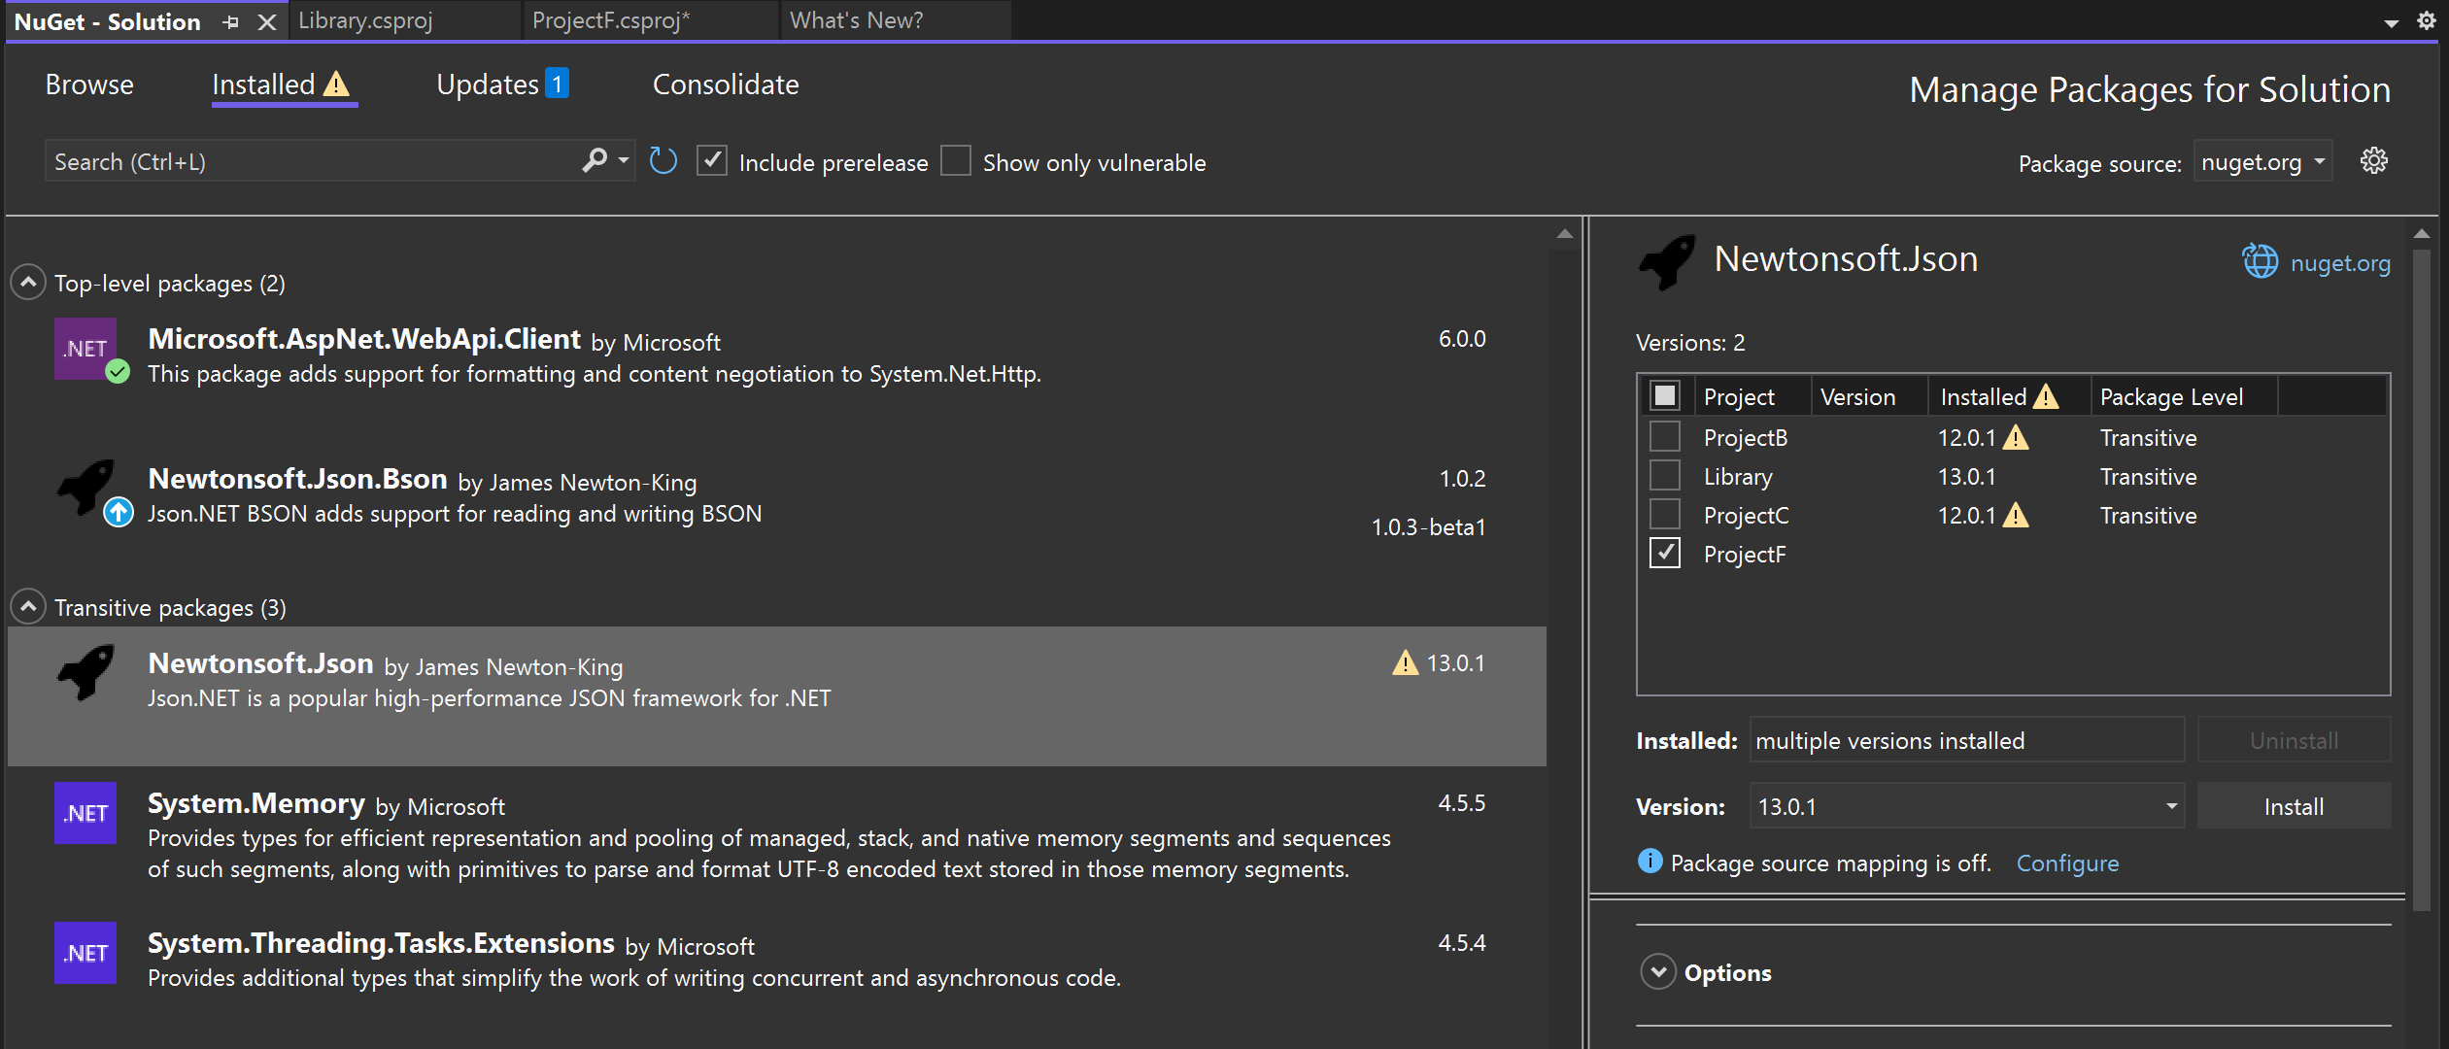
Transitive Dependencies
Know your hidden dependencies
Supported in project & solution level.
New “Transitive packages” collapsable list
Warning alerts for any known vulnerability
Know which projects are affected and which versions are vulnerable.
* Solution level experience is now in Visual Studio 17.12.

Slide 6
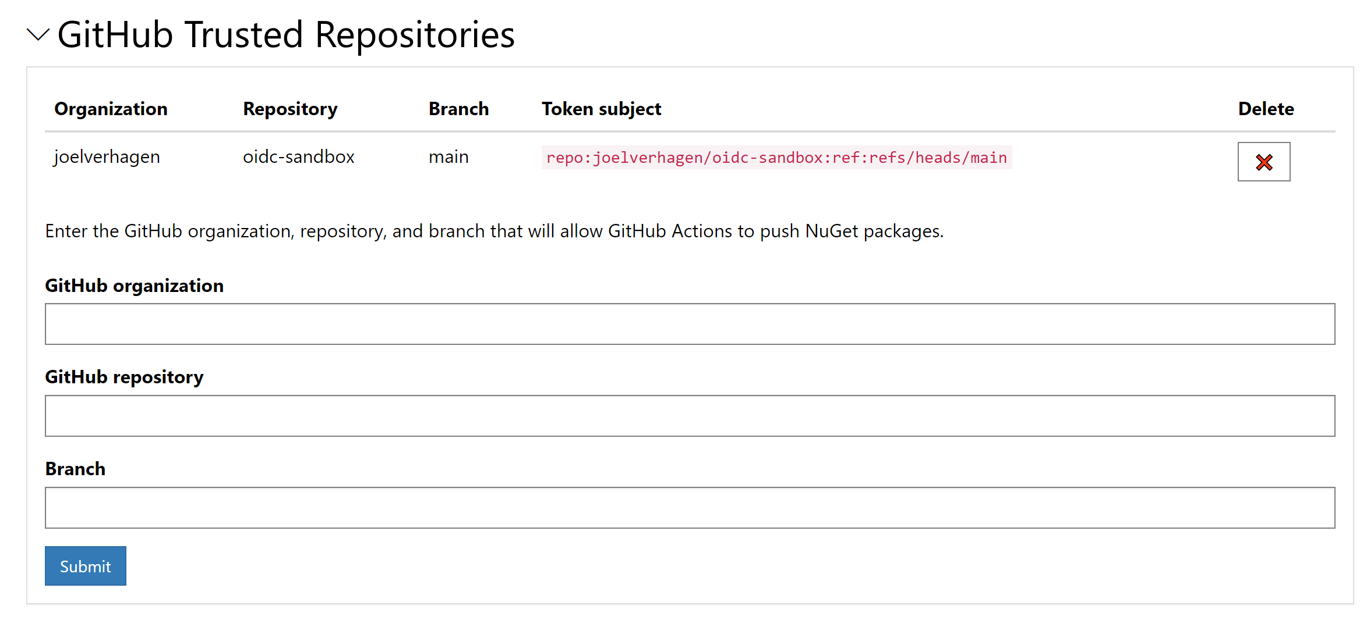
OIDC Trusted Publishers
Replaces long-lived API keys with short-lived tokens for better CI/CD security
Supports GitHub Actions and Azure DevOps pipelines
Verifies publishers to reduce risks from compromised accounts and supply chain attacks
* In active development.

Slide 7
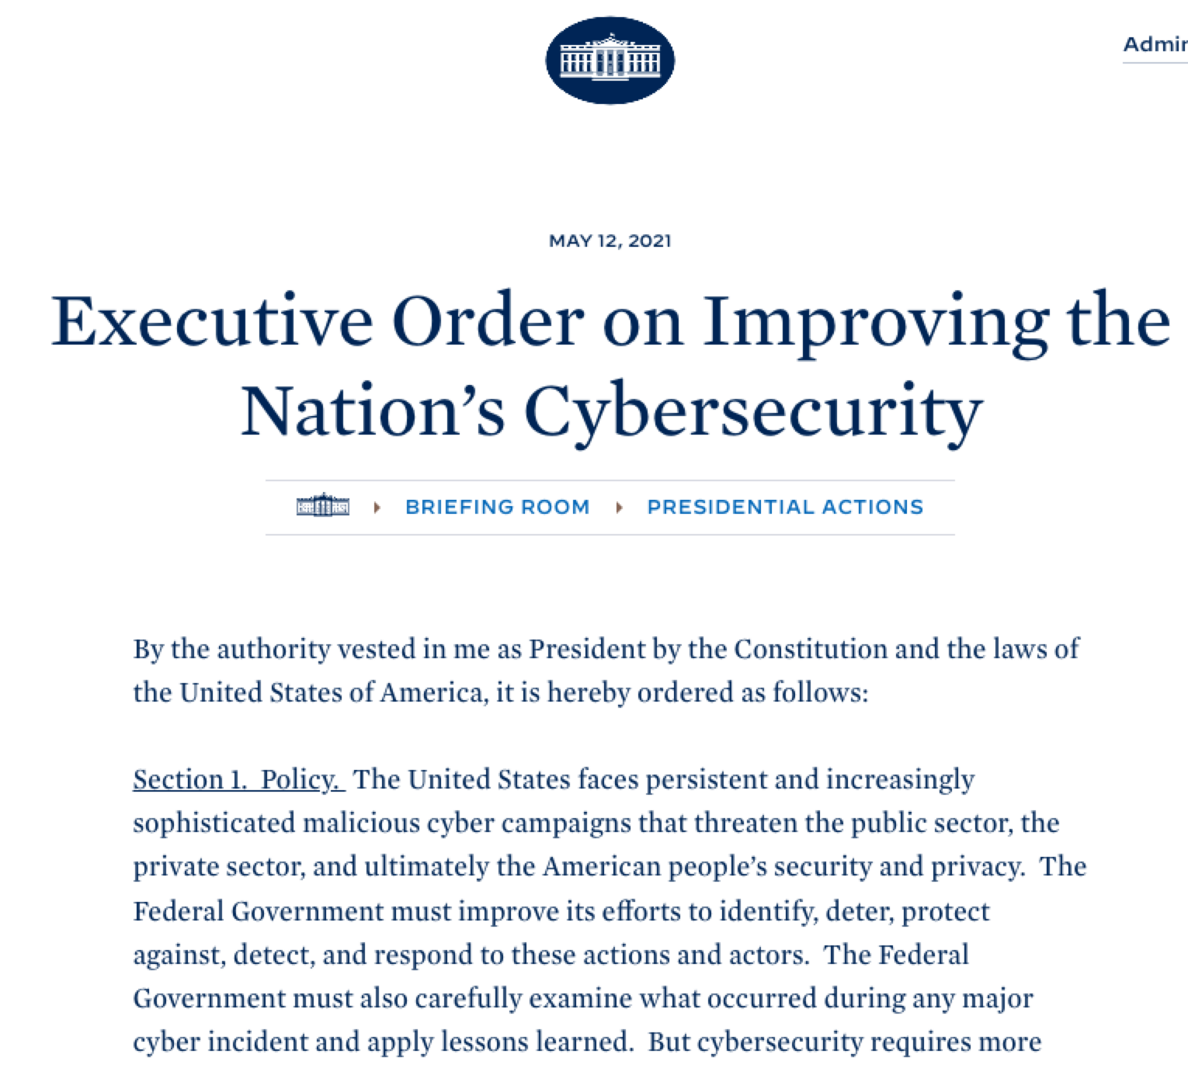
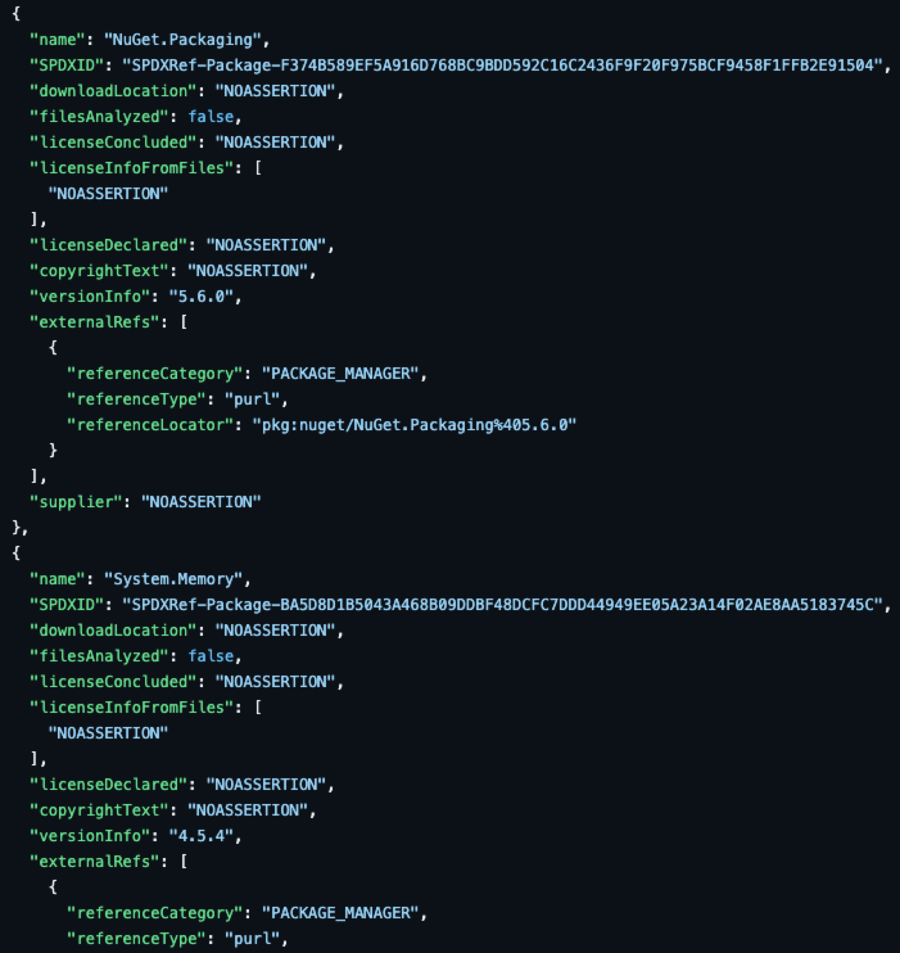
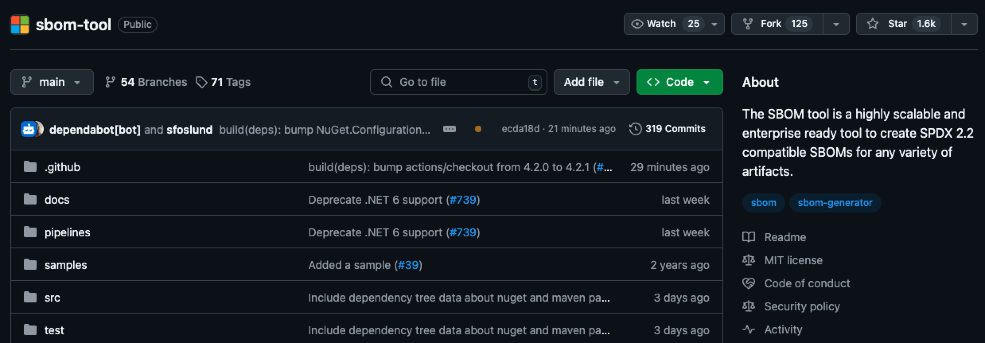
SBOMs + NuGet
A SBOM (Software Bill of Materials) is a detailed list of all components and dependencies in a software project, helping track licenses, vulnerabilities, and security risks.
Install the NuGet package: Microsoft.Sbom.Targets
Add <GenerateSBOM>true</GenerateSBOM> to your project file
The SBOM is automatically generated in your NuGet package!
* In active development.

Slide 8
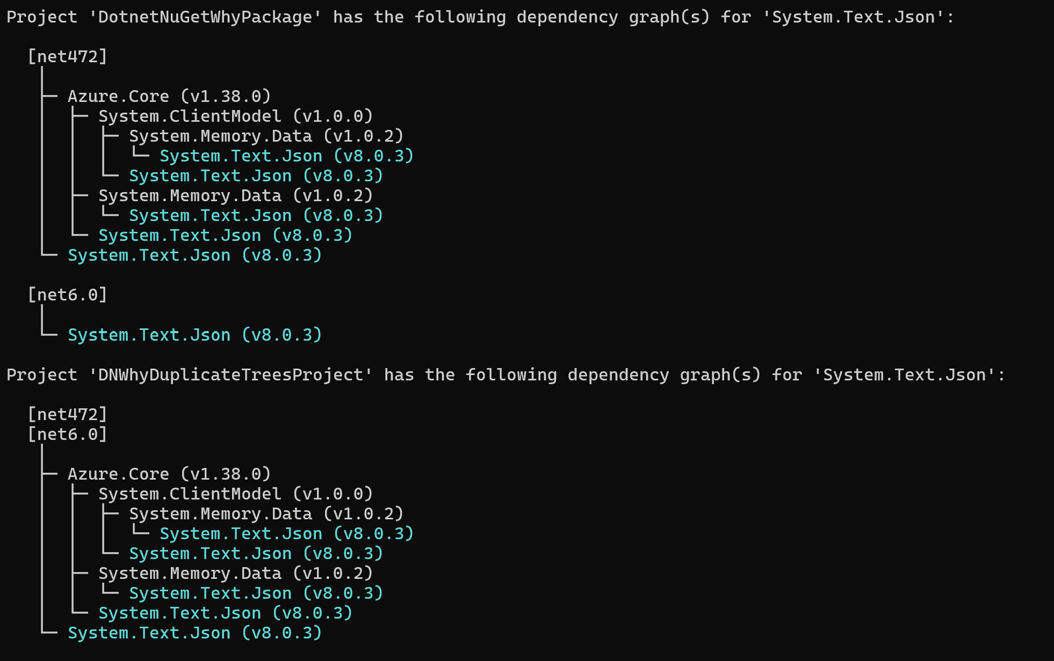
dotnet nuget why
Displays the full dependency graph for a specific package within a project or solution
Helps identify where a package is being used, including transitive dependencies
Useful for debugging dependency issues or understanding package relationships
Shows multiple target frameworks if applicable (as shown in the image)
* In .NET 8.0.4XX+.

Slide 9



Industry Partnerships
OpenSSF
GitHub
deps.dev
Scorecard support and trusted publishers partnerships
Advisory database and Dependabot 2.0 partnerships
NuGet support for opensource insights

Slide 10
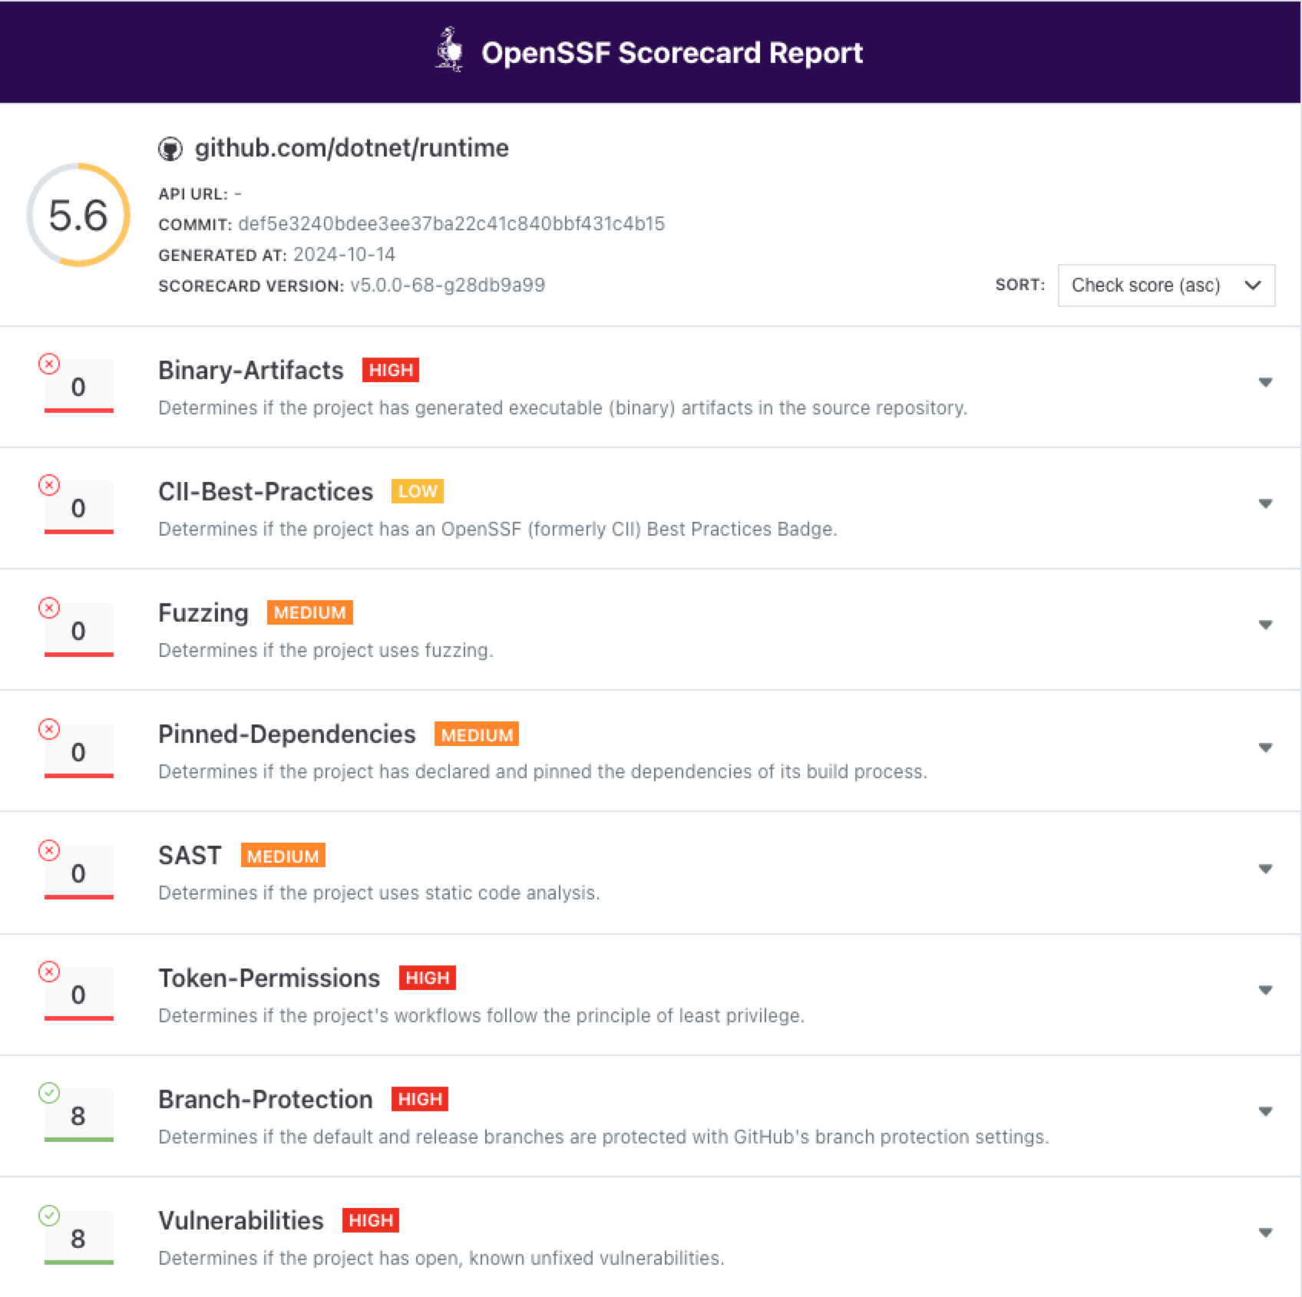
OpenSSF Scorecard
Contributed initial pinned-dependencies checks
Actively working on providing guidance to various .NET teams
Focused on improving repository best practices
Aiming to enhance overall scores across repositories
Support for CPM/lock files soon

Slide 11
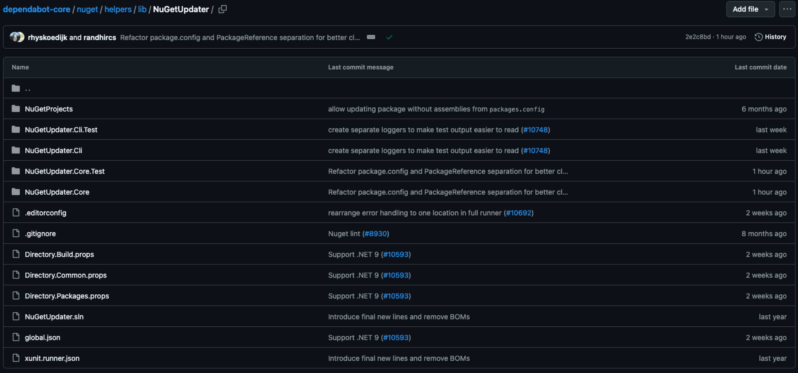
Dependabot 2.0
Dependabot has transitioned from an old Ruby script to an official implementation
Utilizes NuGet restore in the new implementation
Supports new features like Central Package Management
Can now detect <PackageVersion>
* Available today.

Slide 12
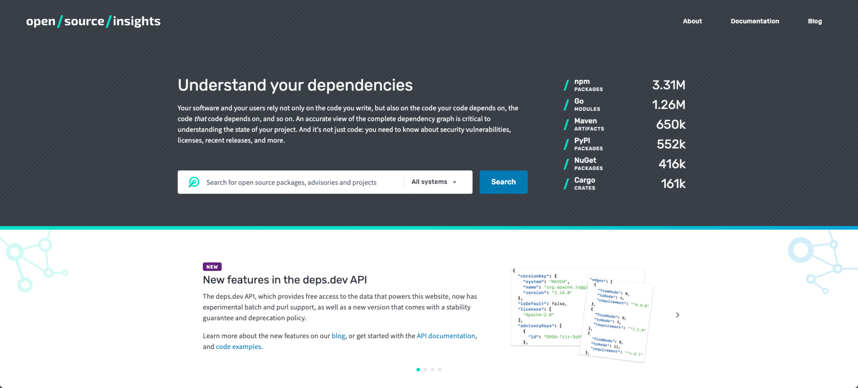
deps.dev
NuGet is supported on open source insights
Deps.dev supports various experiments towards understanding your dependencies such as security vulnerabilities, licenses, recent releases, OpenSSF Scorecards, etc.

Slide 13
Dark mode on NuGet.org
What else is new?
C# Dev Kit – NuGet Commands
#packages in Copilot
NuGet dependency resolver

Slide 14
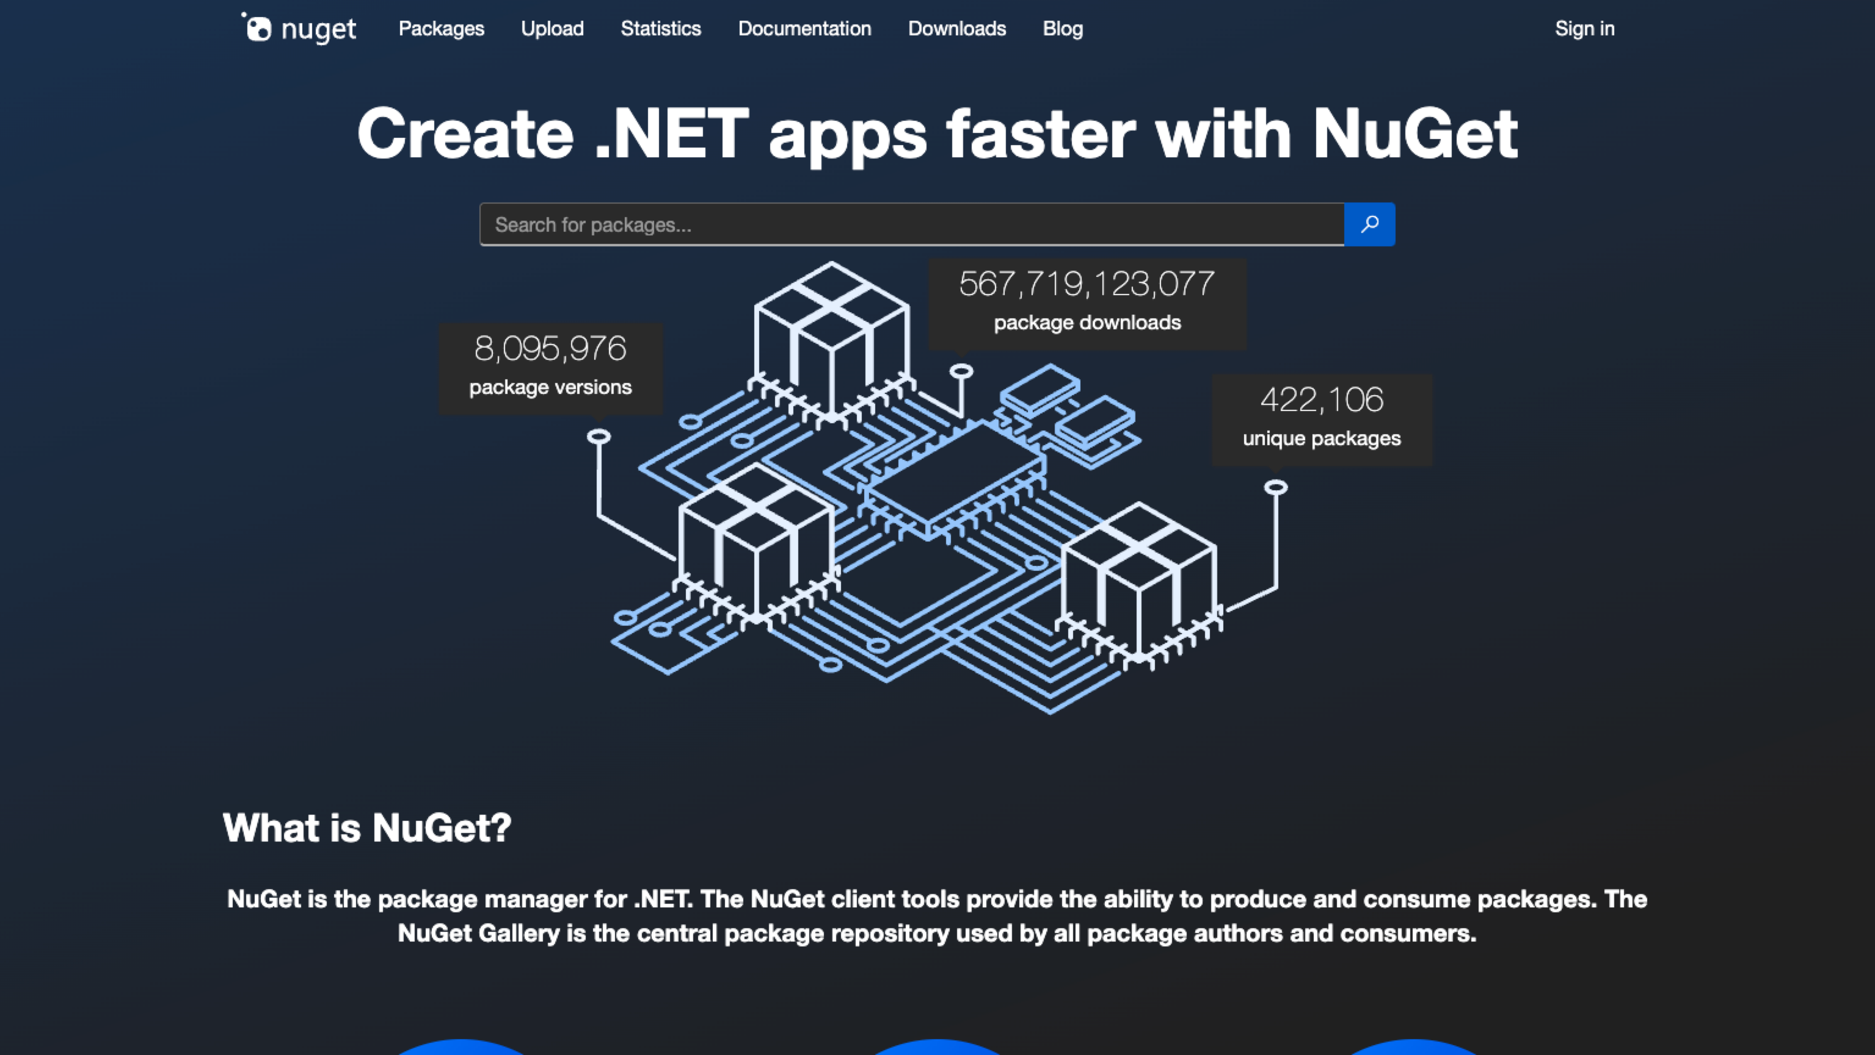
Dark Mode on NuGet.org

Slide 15
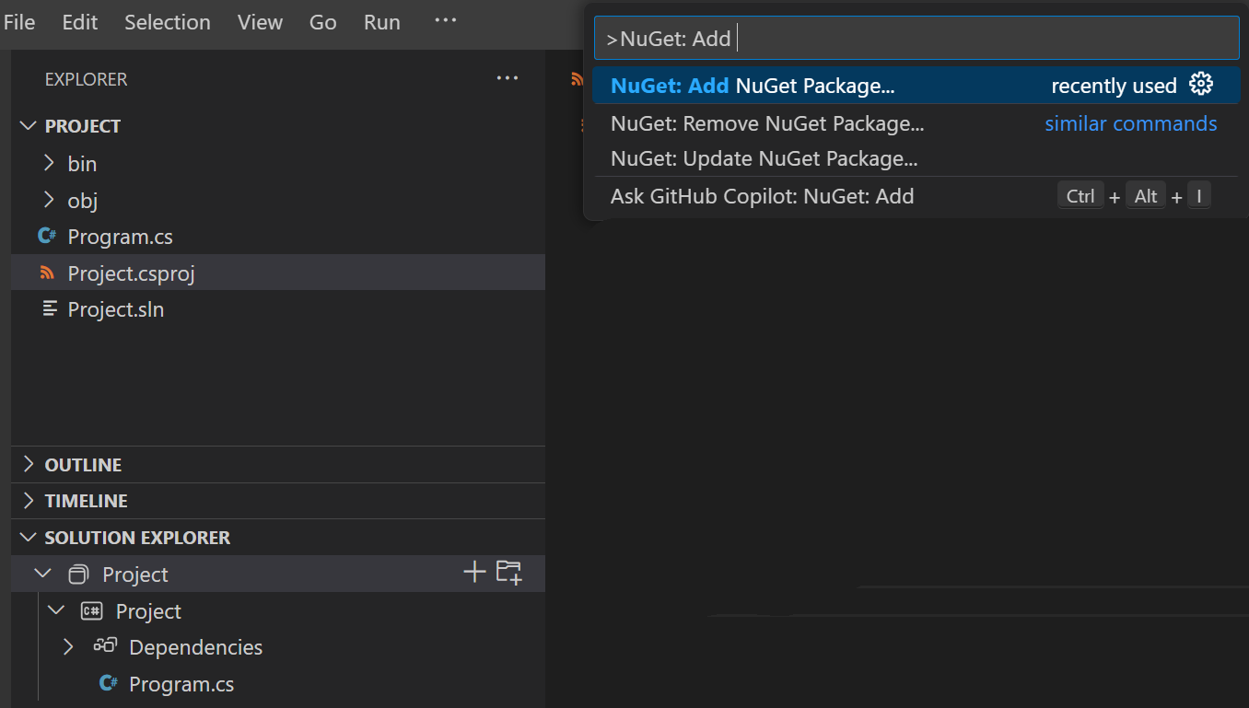
C# Dev Kit – NuGet Commands

Slide 16
NuGet Dependency Resolver
Written from the ground up
The new restore algorithm significantly boosts performance for large projects, making dependency management faster and more efficient across all PackageReference projects.
The restore algorithm was rewritten to improve performance and scalability, which is now enabled by default.
If restore failures occur, revert to the legacy dependency resolver by setting RestoreUseLegacyDependencyResolver to true.
OrchardCore | 20-core | 8-core
Arctic | -31.7% | -15.0%
Cold | -11.9% | -17.7%
Offline | -22.5% | -21.5%
Force | -23.8% | -22.6%
Noop | -4.9% | -1.9%
* Included in .NET 9, Visual Studio 17.12, and NuGet 6.12

Slide 17
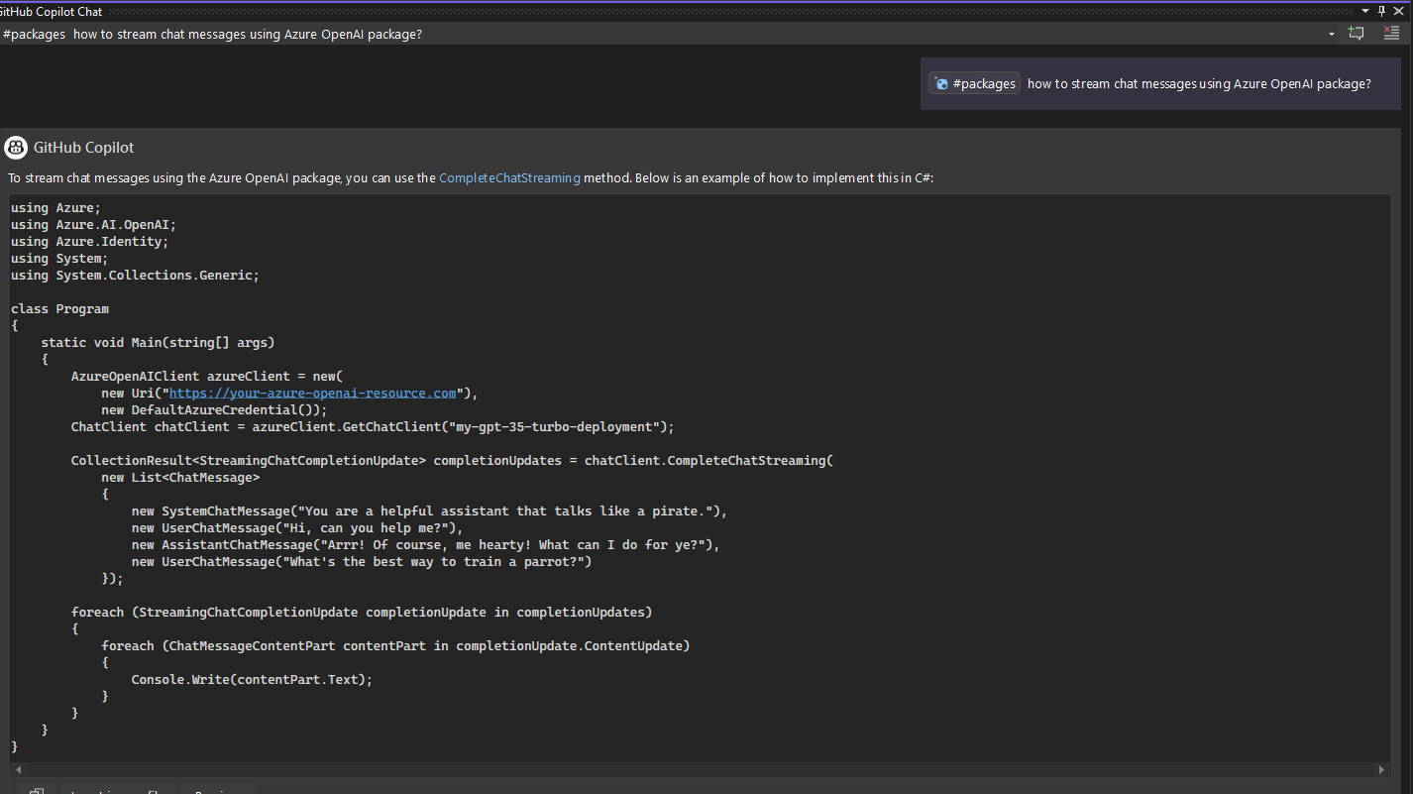
#packages in Copilot
Bring more context from your packages
Use #packages when using GitHub Copilot in Visual Studio to bring in the context of your packages.
Ask questions like how to use a capability from a package and it will pull in more package context like a README file.
* In active development

Slide 18
Thank you

